Slide 1
UNIT 6 Live Session
Contrasts
Multiple Comparison

Slide 2
Overview
ANOVA provides an F-test for equality of several means
The main weaknesses are
It doesn’t tell us which means are different
It doesn’t account for any structure in the groups
The downside to this more refined analysis is that we need to control for the number of comparisons we end up making
(Example: Is the average treatment effect across 3 levels of treatments different from the placebo?)

Slide 3
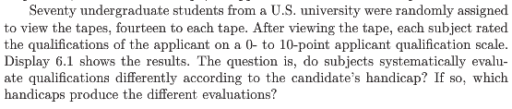
Example: Handicap & Capability Study
Goal: How do physical handicaps affect perception of employment qualification?
(Cesare, Tannenbaum, and Dalessio “Interviewers’ decisions related to applicant handicap type and rater empathy” (1990) Human Performance)
The researchers prepared 5 video taped job interviews with same actors
The tapes differed only in the handicap of the applicant:
No handicap (This is the control group)
One leg amputated
Crutches
Hearing Impaired
Wheelchair
14 students were randomly assigned to each tape to rate applicants: 0-10 pts (70 students total.)

Slide 4
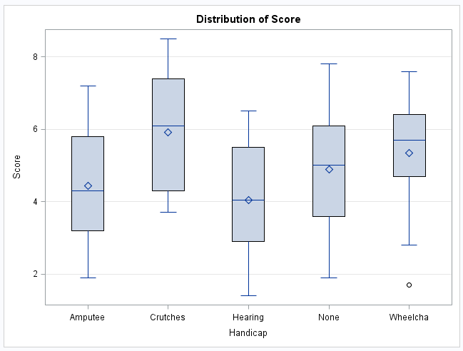
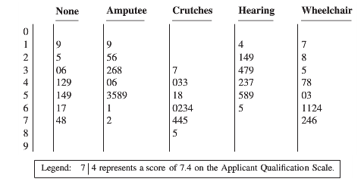
Example: Handicap & Capability Study
Do subjects systematically evaluate qualifications differently according to handicap?
If so, which handicaps are evaluated differently?

Slide 5







Is There Any Difference at All?
We should begin any analysis involving several groups by using the ANOVA framework
If there isn’t any (statistically) significant difference in the population means, then there is no reason to address more refined questions
The tapes differed only in the handicap of the applicant:
No handicap (This is the control group.)
One leg amputated
Crutches
Hearing Impaired
Wheelchair
$${(μ}_{None})$$
$${(μ}_{Amp})$$
$${(μ}_{Crutch})$$
$${(μ}_{Hear})$$
$${(μ}_{Wheel})$$
ANOVA: $H_{0}:μ_{1}$=$μ_{2}$=$μ_{3}$=$μ_{4}$=$μ_{5}$
$H_{A}:μ_{j}≠μ_{k}$ for some $j,k$

Slide 6
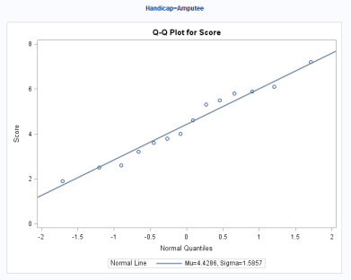
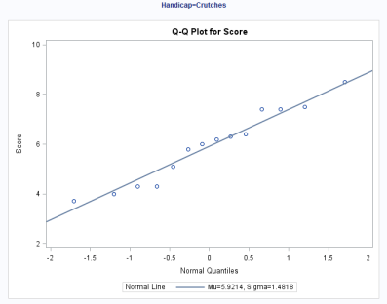
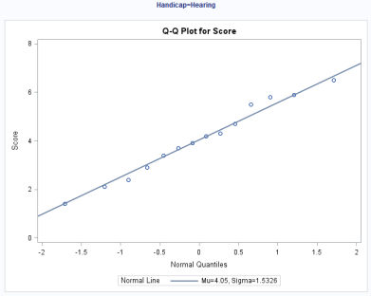
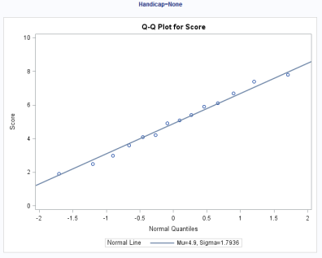
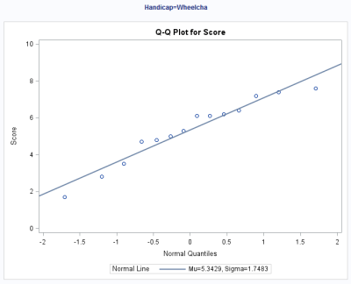
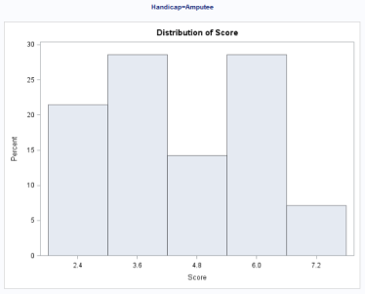
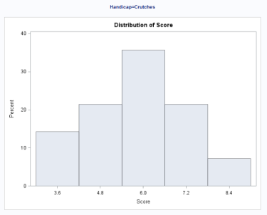
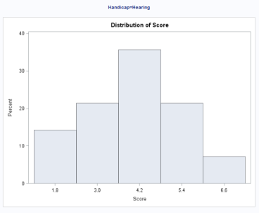
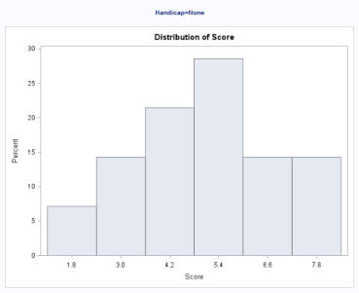
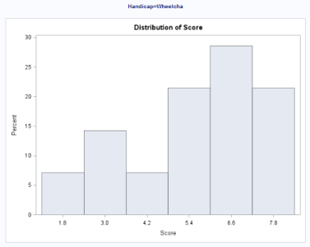
Handicap & Capability Study: Normality Assumption
There is NO visual evidence to suggest that the data are not normally distributed. We will proceed with the assumption of normally distributed groups.

Slide 7
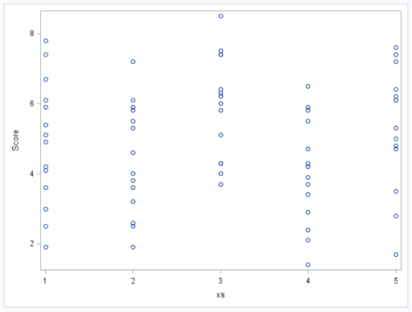
Handicap & Capability Study: Equal Variances Assumption
There is NO evidence to suggest variances are unequal.

Slide 8
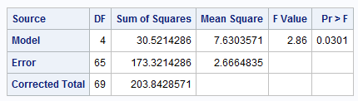
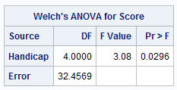


Handicap & Capability Study: ANOVA results
$H_{0}:μ_{1}$=$μ_{2}$=$μ_{3}$=$μ_{4}$=$μ_{5}$ ($μ$)
$H_{A}:μ_{j}≠μ_{k}$ for some $j,k$
There is evidence to support the claim that at least two population means are different from each other (p-value of 0.0301 from a 1-way ANOVA).
Notice that since there is virtually no evidence of a difference in standard deviations, Welch’s test is almost identical to the pure F ANOVA.

Slide 9
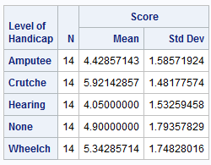

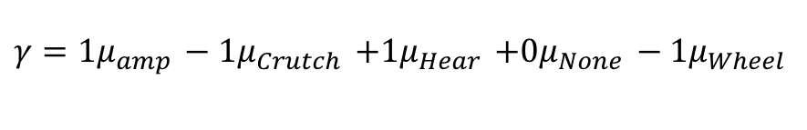
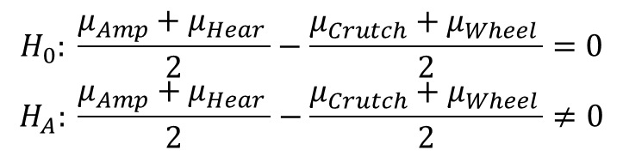
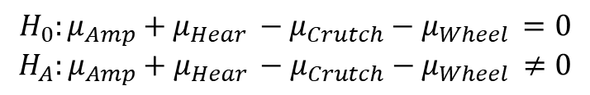

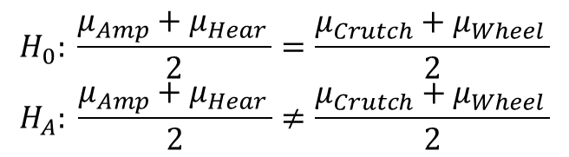

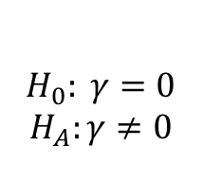

Handicap & Capability Study: More Specific Questions
$$H_{0}: \frac{μ_{Amp}+μ_{Hear }}{2}=\frac{μ_{Crutch}+μ_{Wheel }}{2}$$
$$H_{A}: \frac{μ_{Amp}+μ_{Hear }}{2}≠\frac{μ_{Crutch}+μ_{Wheel }}{2}$$
$$↕$$
$$H_{0}: \frac{μ_{Amp}+μ_{Hear }}{2}−\frac{μ_{Crutch}+μ_{Wheel }}{2}=0$$
$$H_{A}: \frac{μ_{Amp}+μ_{Hear }}{2}−\frac{μ_{Crutch}+μ_{Wheel }}{2}≠0$$
$$↕$$
$$H_{0}:{μ_{Amp}+μ_{Hear }−μ}_{Crutch}−μ_{Wheel }=0$$
$$H_{A}:{μ_{Amp}+μ_{Hear }−μ}_{Crutch}−μ_{Wheel }≠0$$
$$↕$$
(contrast)
$γ=1μ_{amp }−1μ_{Crutch }$ $+1μ_{Hear }$ $+0μ_{None }−1μ_{Wheel}$
$$↔$$
$${ H}_{0}: γ=0$$
$$H_{A}:γ≠0$$

Slide 10



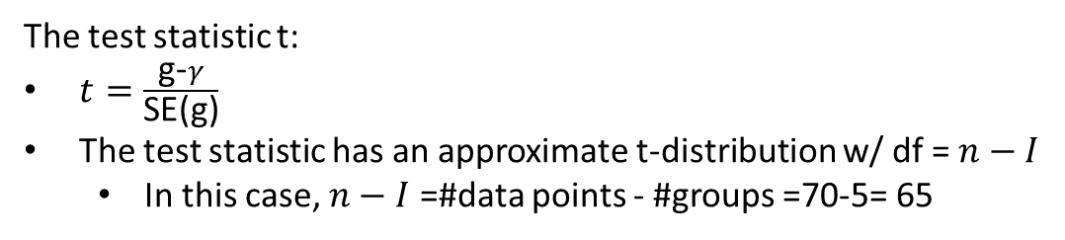
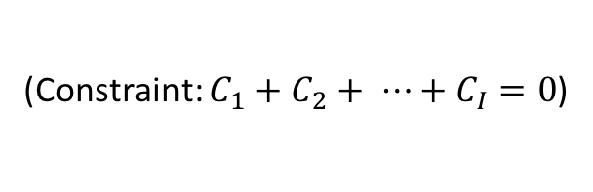
Linear Combinations & Contrasts
(Constraint: $C_{1}+C_{2}+ ⋯+C_{I}=0$)
(this requires independence)
Example: $γ=1μ_{Amp}−1μ_{Crutch}$ $+1μ_{Hear}$ $+0μ_{None}−1μ_{Wheel}$
The test statistic t:
$t=\frac{\text{g}\text{−}γ}{\text{SE}\text{(}\text{g}\text{)}}$
The test statistic has an approximate t-distribution w/ df =$n−I$
In this case, $n−I$ =#data points - #groups =70-5= 65

Slide 11
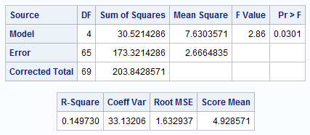
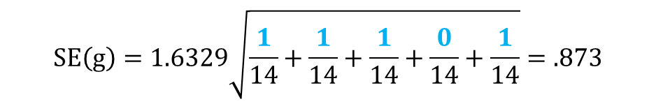
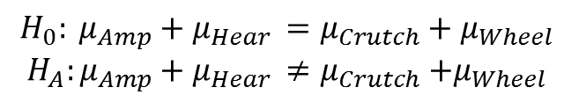
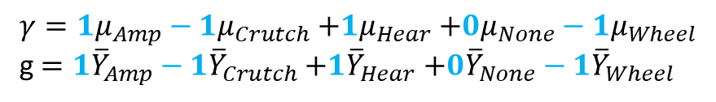
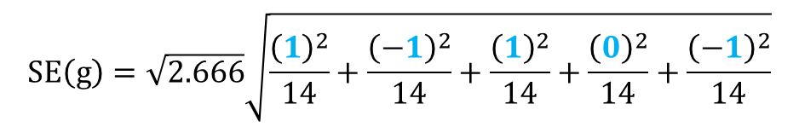
Handicap & Capability Study: A Contrast
Calculate mean difference and standard error.
$$H_{0}: μ_{Amp}+μ_{Hear }=μ_{Crutch}+μ_{Wheel }$$
$$H_{A}:μ_{Amp}+μ_{Hear }≠μ_{Crutch}{+μ}_{Wheel }$$
$γ=1μ_{Amp}−1μ_{Crutch}$ $+1μ_{Hear}$ $+0μ_{None}−1μ_{Wheel}$
g$=1{\overline{Y}}_{Amp}−1{\overline{Y}}_{Crutch}$ $+1{\overline{Y}}_{Hear}$ $+0{\overline{Y}}_{None}−1{\overline{Y}}_{Wheel}$
$g=\left(1\right)4.4−\left(1\right)5.9$ + ($1$)4.1 + (0)4.9 – ($1$)5.3 = - 2.8
$$SE\left(g\right)=\sqrt{2.666}\sqrt{\frac{{\left(1\right)}^{2}}{14}+\frac{{\left(−1\right)}^{2}}{14}+\frac{{\left(1\right)}^{2}}{14}+\frac{{\left(0\right)}^{2}}{14}+\frac{{\left(−1\right)}^{2}}{14}}$$
$$SE\left(g\right)=1.6329\sqrt{\frac{1}{14}+\frac{1}{14}+\frac{1}{14}+\frac{0}{14}+\frac{1}{14}}=.873$$

Slide 12
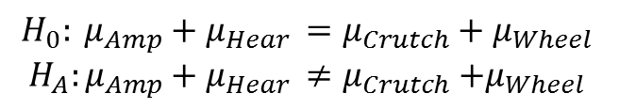
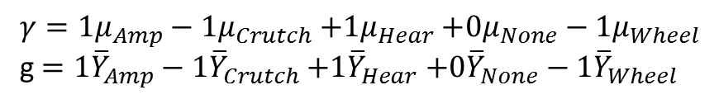


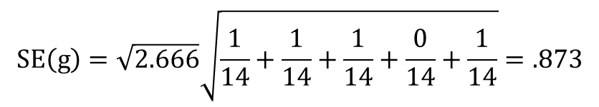

Handicap & Capability Study: A Contrast
Confidence Intervals for $γ$
$$H_{0}: μ_{Amp}+μ_{Hear }=μ_{Crutch}+μ_{Wheel }$$
$$H_{A}:μ_{Amp}+μ_{Hear }≠μ_{Crutch}{+μ}_{Wheel }$$
$γ=1μ_{Amp}−1μ_{Crutch}$ $+1μ_{Hear}$ $+0μ_{None}−1μ_{Wheel}$
g$=1{\overline{Y}}_{Amp}−1{\overline{Y}}_{Crutch}$ $+1{\overline{Y}}_{Hear}$ $+0{\overline{Y}}_{None}−1{\overline{Y}}_{Wheel}$
$g=\left(1\right)4.4−\left(1\right)5.9$ + (1)4.1 + (0)4.9 – (1)5.3 = - 2.8
$$SE\left(g\right)=\sqrt{2.666}\sqrt{\frac{1}{14}+\frac{1}{14}+\frac{1}{14}+\frac{0}{14}+\frac{1}{14}}=.873$$
There is evidence that the sum of points assigned to Amp & Hear handicaps is smaller than the sum of points assigned to Crutch & Wheel handicaps at level alpha equal to 0.05 because the CI does not contain 0.
CI: Point estimate ± multiplier* standard error
95% t-tools CI for $γ$: $−2.78577 ±(1.9971)(0.87286)$
95% t-tools CI for $γ$: $−2.78577 ±1.74319$
95% t-tools CI for $γ$: (-4.529, -1.043)

Slide 13
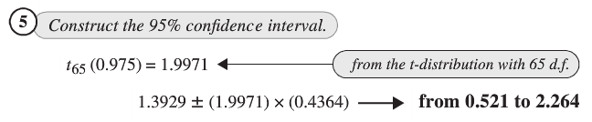

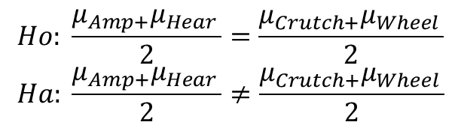
Chapter 6: Compare with book!
$$Ho: \frac{μ_{Amp+}μ_{Hear }}{2}=\frac{μ_{Crutch+}μ_{Wheel }}{2}$$
$$Ha: \frac{μ_{Amp+}μ_{Hear }}{2}≠\frac{μ_{Crutch+}μ_{Wheel }}{2}$$
Note the sign switch and division by 2 of the coefficients.
$γ=−0.5μ_{Amp}+0.5μ_{Crutch}$ -$0.5μ_{Hear}$ $+0μ_{None}+0.5μ_{Wheel}$

Slide 14
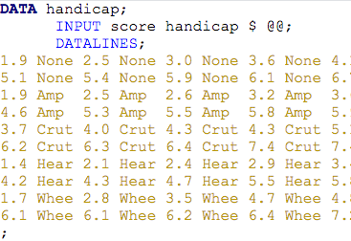
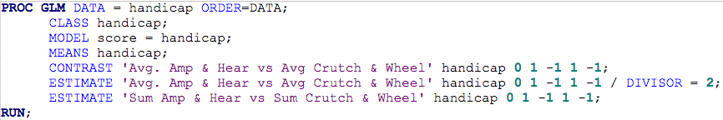
Handicap & Capability Study: In SAS
Order = data keeps the data in the order it came in, so that “none” group is first and can be assigned a coefficient of 0.
Comes in handy when doing division by hand would result in the need to input a rounded number (example 0.33)

Slide 15

Handicap & Capability Study: In SAS
$γ=1μ_{Amp}−1μ_{Crutch}$ $+1μ_{Hear}$ $+0μ_{None}−1μ_{Wheel}$
$γ=0.5μ_{Amp}−0.5μ_{Crutch}$ $+0.5μ_{Hear}$ $+0μ_{None}−0.5μ_{Wheel}$
Three different ways (contrast, estimate, estimate with divisor =2) to test for the same idea. (There are many more than three!)

Slide 16
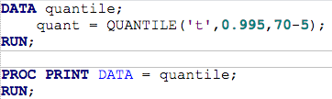

Handicap & Capability Study: In SAS
Confidence Intervals
There is evidence that the average points assigned to Amp & Hear handicaps is smaller than the average points assigned to Crutch & Wheel handicaps (t-tools linear contrast p-value of 0.0022). We estimate that this difference is -1.39 pts with an associated 99% confidence interval of….
99% CI for the difference in averages of Amp and Hear vs. Crutch and Wheel:
Point estimate ± multiplier* standard error
-1.39±2.65*0.436
-1.39±1.155
(-2.55, -0.23), which of course does not include 0

Slide 17

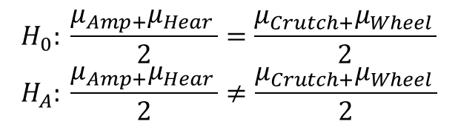
Chapter 6
$$H_{0}: \frac{μ_{Amp+}μ_{Hear }}{2}=\frac{μ_{Crutch+}μ_{Wheel }}{2}$$
$$H_{A}: \frac{μ_{Amp+}μ_{Hear }}{2}≠\frac{μ_{Crutch+}μ_{Wheel }}{2}$$
$γ=1μ_{Amp}−1μ_{Crutch}$ $+1μ_{Hear}$ $+0μ_{None}−1μ_{Wheel}$
With no Order = data in the code, the contrasts are assigned in alphabetical order, so that “none” group is fourth.

Slide 18
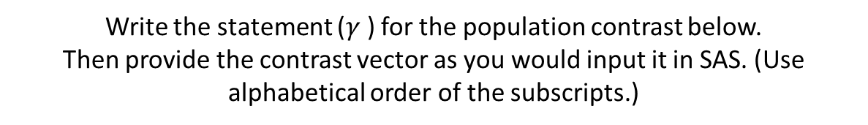
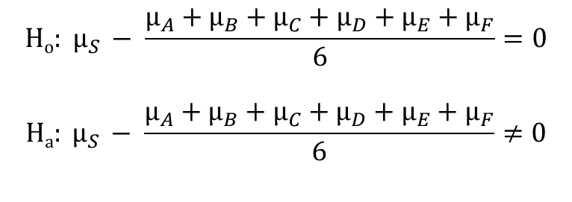

Let’s Try Some!!!
Groups: A, B, C, D, E, F, S
Write the statement ($γ$) for the population contrast below.
Then provide the contrast vector as you would input it in SAS. (Use alphabetical order of the subscripts.)
$$Ho: μ_{S }− \frac{μ_{A}+μ_{B}+μ_{C}+μ_{D}+μ_{E}+μ_{F}}{6}=0$$
$$Ha: μ_{S }− \frac{μ_{A}+μ_{B}+μ_{C}+μ_{D}+μ_{E}+μ_{F}}{6}≠0$$
$$γ=$$
Contrast vector (assume alphabetical order):
Answer on Next Slide ->

Slide 19
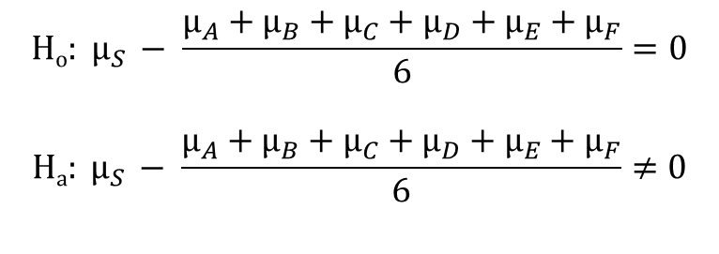
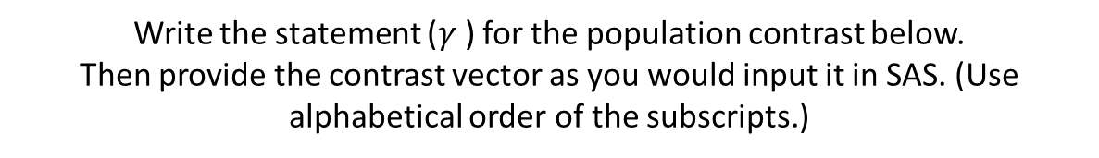
Let’s Try Some!!!
Groups: A, B, C, D, E, F, S
Write the statement ($γ$) for the population contrast below.
Then provide the contrast vector as you would input it in SAS. (Use alphabetical order of the subscripts.)
$$Ho: μ_{S }− \frac{μ_{A}+μ_{B}+μ_{C}+μ_{D}+μ_{E}+μ_{F}}{6}=0$$
$$Ha: μ_{S }− \frac{μ_{A}+μ_{B}+μ_{C}+μ_{D}+μ_{E}+μ_{F}}{6}≠0$$
$γ=−1μ_{A }−1μ_{B }−1μ_{C}$ $−1μ_{D }$ $−1μ_{E }$ $−1μ_{F}$ + $6μ_{S }$
Contrast vector (assume alphabetical order): -1 -1 -1 -1 -1 -1 6

Slide 20
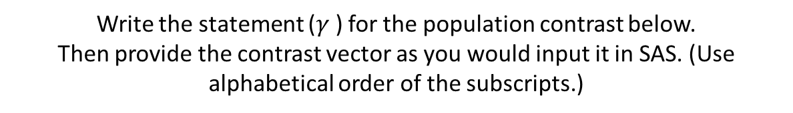
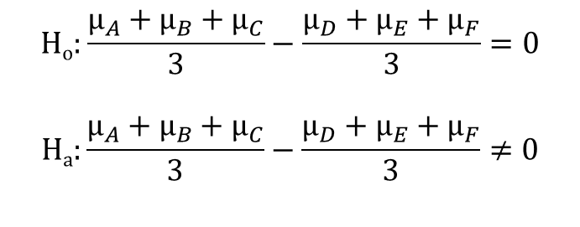

Let’s Try ANOTHER!!!
Groups: A, B, C, D, E, F, S
Write the statement ($γ$) for the population contrast below.
Then provide the contrast vector as you would input it in SAS. (Use alphabetical order of the subscripts.)
$$Ho:\frac{μ_{A}+μ_{B}+μ_{C}}{3}−\frac{μ_{D}+μ_{E}+μ_{F}}{3}=0$$
$$Ha:\frac{μ_{A}+μ_{B}+μ_{C}}{3}−\frac{μ_{D}+μ_{E}+μ_{F}}{3}≠0$$
$$γ=$$
Contrast vector (assume alphabetical order):

Slide 21
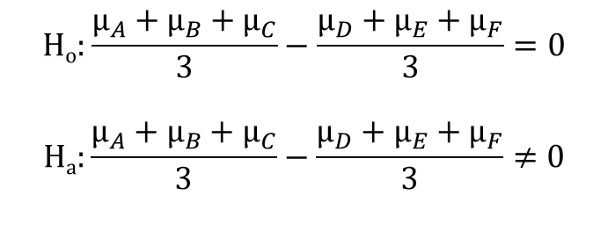
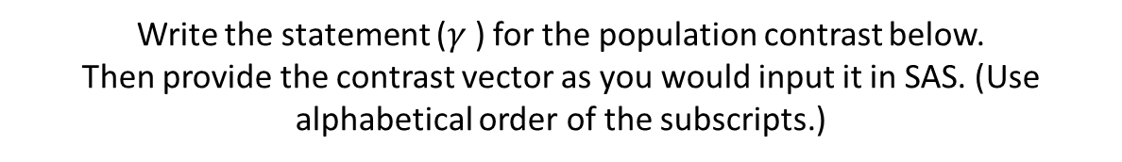
Let’s Try ANOTHER!!!
Groups: A, B, C, D, E, F, S
Write the statement ($γ$) for the population contrast below.
Then provide the contrast vector as you would input it in SAS. (Use alphabetical order of the subscripts.)
$$Ho:\frac{μ_{A}+μ_{B}+μ_{C}}{3}−\frac{μ_{D}+μ_{E}+μ_{F}}{3}=0$$
$$Ha:\frac{μ_{A}+μ_{B}+μ_{C}}{3}−\frac{μ_{D}+μ_{E}+μ_{F}}{3}≠0$$
$γ=$ ${1μ}_{A }+1μ_{B }+1μ_{C}$ $−1μ_{D }$ $−1μ_{E }$ $−1μ_{F}$+ $0μ_{S }$
Contrast vector (assume alphabetical order): 1 1 1 -1 -1 -1 0
ADDITIONAL QUESTION:
Why is it better to include the Spock data in the calculation of the pooled SD (and thus the MSE) even though the hypothesis does not include it?

Slide 22
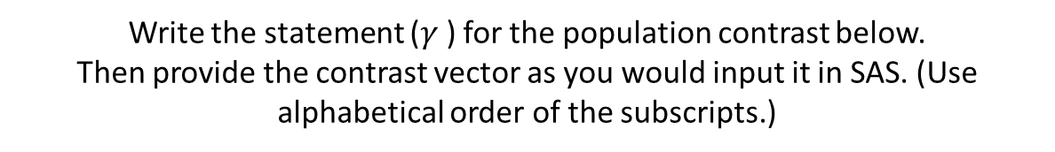
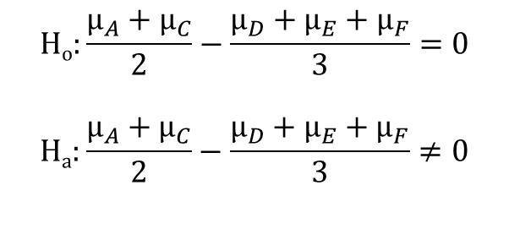

Let’s Try ONE MORE!!!
Groups: A, B, C, D, E, F, S
Write the statement ($γ$) for the population contrast below.
Then provide the contrast vector as you would input it in SAS. (Use alphabetical order of the subscripts.)
$$Ho:\frac{μ_{A}+μ_{C}}{2}−\frac{μ_{D}+μ_{E}+μ_{F}}{3}=0$$
$$Ha:\frac{μ_{A}+μ_{C}}{2}−\frac{μ_{D}+μ_{E}+μ_{F}}{3}≠0$$
$$γ=$$
Contrast vector (assume alphabetical order):
Answer on Next Slide ->

Slide 23
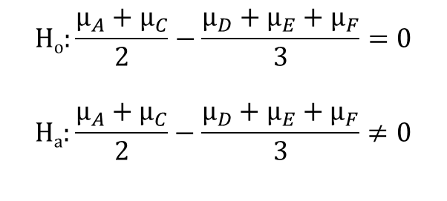
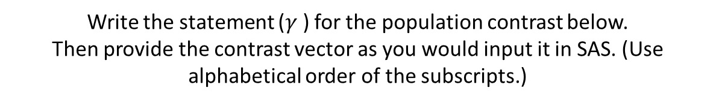
Let’s Try ONE MORE!!!
Groups: A, B, C, D, E, F, S
Write the statement ($γ$) for the population contrast below.
Then provide the contrast vector as you would input it in SAS. (Use alphabetical order of the subscripts.)
$$Ho:\frac{μ_{A}+μ_{C}}{2}−\frac{μ_{D}+μ_{E}+μ_{F}}{3}=0$$
$$Ha:\frac{μ_{A}+μ_{C}}{2}−\frac{μ_{D}+μ_{E}+μ_{F}}{3}≠0$$
$γ=3μ_{A }+0μ_{B }+3μ_{C}$ $−2μ_{D }$ $−2μ_{E }$ $−2μ_{F}+0μ_{S }$
Contrast vector (assume alphabetical order): 3 0 3 -2 -2 -2 0

Slide 24





Multiple Comparison: Motivation
One Test:
P(Rejecting H_{o} | H_{o} is true) = $α_{Individual}$
K Tests:
$α_{Family}=$P(Rejecting at least 1 H_{o} | All H_{o} are true) $≠$ $α_{Individual}$
K tests
When all tests are independent and have the same alpha ($α_{Individual}$),
$$α_{Family}=1−{(1−α_{Individual})}^{k}$$
Regardless of independence,$α_{Individual}≈\frac{α_{Family}}{k}$, the Bonferroni correction, where $α_{Family}$ is typically controlled for, perhaps set at 0.05.

Slide 25



Multiple Comparison: Example k = 37
Gene 1
Gene 5
Gene 9
Gene 34
Gene 2
Gene 6
Gene 10
Gene 35
Gene 3
Gene 7
Gene 11
Gene 36
Gene 4
Gene 8
Gene 12
Gene 37
$α_{Family}=$Probability (Reject at least 1 H_{o}| µ_{i} = 0 (All n H_{o}’s are true)) = 1 – (1- $α$_{i}) ^{n}
$$αi=.05$$
$α_{Family}=$ 1 – (1-0.05) ³⁷= 1 – (0.95) ³⁷= 0.850……85% chance of a Type I error
$α_{i}=$.05/37
$α_{Family}=$ 1 – [1-(0.05/37)] ³⁷= 1 – (.99865) ³⁷= 0.0488 ……5% chance of a Type I error

Slide 26

Multiple Comparison: Example k = 100
Gene 1
Gene 5
Gene 9
Gene 97
Gene 2
Gene 6
Gene 10
Gene 98
…
Gene 3
Gene 7
Gene 11
Gene 99
Gene 4
Gene 8
Gene 12
Gene 100
$α_{Family}=$Probability (Reject at least 1 H_{o}| µ_{i} = 0 (All n H_{o}’s are true)) = 1 – (1- $α$_{i}) ^{n}
$$αi=.05$$
$α_{Family}=$ 1 – (1-0.05) ¹⁰⁰= 1 – (0.95) ¹⁰⁰= 0.994……99% chance of a Type I error
$α_{i}=$.05/100
$α_{Family}=$ 1 – [1-(0.05/100)] ¹⁰⁰= 1 – (.9995) ¹⁰⁰= 0.0488……5% chance of a Type I error

Slide 27
Confidence Intervals
When we make a correction for multiple comparisons, it is the critical value in the hypothesis test and thus the multiplier in the confidence interval that is adjusted.
*The multiplier is usually the same as the critical value for a hypothesis test.

Slide 28

Planned & Post-hoc Tests
A planned test is one in which you know the comparisons (tests) you want to make before you look at the data.
If you have k planned comparisons then you need to correct for just those k comparisons.
When planned comparisons are not obvious, post hoc tests are conducted. In this case, we need to correct for all possible k comparisons between the m groups.
$$k= \frac{m(m−1)}{2}$$

Slide 29
Post-Hoc / Unplanned Tests
Post Hoc tests are appropriate when:
The researcher wants to examine all possible comparisons among pairs of group means (or a large number of comparisons).
Predictions about which groups will differ are not made prior to setting up the analysis.

Slide 30

Multiple Comparison: Bonferroni
If the confidence level for each of k individual comparisons is adjusted upward to 100$\left(1−\frac{α}{k}\right)\%$, the chance that all intervals succeed simultaneously is at least 100$\left(1−α\right)\%$
$$multiplier= t_multiplier=t_{\left(1−\frac{α}{2k}\right),df}$$
For a set of Bonferroni adjusted t-tests, (α/k) we must have normal distributions, equal spreads, and independence (same as typical t-tests).
However, the Bonferroni correction can be extended to tests that have no assumptions about distributions (e.g. rank sum test). For any set of independent parametric or non-parametric tests, the Bonferroni correction works the same.
This approach is very conservative, meaning that the intervals are much wider than the nominal level, particularly if the tests are not really independent.

Slide 31

Multiple Comparison: Tukey-Kramer
Studentized Range Statistic Table
Multiplier =
The Tukey-Kramer adjustment is a modification to this test to account for different sample sizes in the groups.
Assumes normal distributions, equal spreads, independence (same as typical t-tests), and equal group sample sizes.
More consistent than Bonferroni with respect to Type I Error but not robust to its assumptions…. Bonferroni is a good alternative when the assumptions are violated.

Slide 32



Multiple Comparison: Dunnett Many Groups to one Control
$$t_{1}=\frac{{\hat{μ}}_{C}−{\hat{μ}}_{1}}{{SE}_{{\hat{μ}}_{C}−{\hat{μ}}_{1}}}$$
Assumes normal distributions, equal spreads, and independence (same as typical t-tests).
$$t_{2}=\frac{{\hat{μ}}_{C}−{\hat{μ}}_{2}}{{SE}_{{\hat{μ}}_{C}−{\hat{μ}}_{2}}}$$
…
$$t_{n}=\frac{{\hat{μ}}_{C}−{\hat{μ}}_{n}}{{SE}_{{\hat{μ}}_{C}−{\hat{μ}}_{n}}}$$
Replaces t-distribution with a multivariate t-distribution (n=# of groups versus control), where the tests are not independent.

Slide 33
Example: T-rex bones
Oxygen | Bone |  | Oxygen | Bone |  | Oxygen | Bone
11.1 | Bone1 |  | 10.92 | Bone5 |  | 10.93 | Bone10
11.22 | Bone1 |  | 11.2 | Bone5 |  | 11.01 | Bone10
11.29 | Bone1 |  | 11.3 | Bone5 |  | 11.08 | Bone10
11.49 | Bone1 |  | 11.62 | Bone5 |  | 11.12 | Bone10
11.32 | Bone2 |  | 11.7 | Bone5 |  | 11.28 | Bone10
11.4 | Bone2 |  | 11.7 | Bone6 |  | 11.37 | Bone10
11.71 | Bone2 |  | 11.79 | Bone6 |  | 11.35 | Bone11
11.6 | Bone3 |  | 11.91 | Bone6 |  | 11.43 | Bone11
11.78 | Bone3 |  | 12.15 | Bone6 |  | 11.5 | Bone11
12.05 | Bone3 |  | 11.33 | Bone7 |  | 11.57 | Bone11
10.61 | Bone4 |  | 11.41 | Bone7 |  | 11.92 | Bone11
10.88 | Bone4 |  | 11.62 | Bone7 |  | 11.95 | Bone12
11.12 | Bone4 |  | 12.15 | Bone7 |  | 12.01 | Bone12
11.24 | Bone4 |  | 12.3 | Bone7 |  | 12.25 | Bone12
11.43 | Bone4 |  | 11.32 | Bone8 |  | 12.3 | Bone12
 |  |  | 11.65 | Bone8 |  | 12.39 | Bone12
 |  |  | 11.96 | Bone8
 |  |  | 12.15 | Bone8
 |  |  | 11.54 | Bone9
 |  |  | 11.89 | Bone9
 |  |  | 12.04 | Bone9

Slide 34


Example: T-rex bones

Slide 35



T-Distribution
62 significant differences
Multiplier for Confidence Interval
2.02108

Slide 36




Tukey-Kramer
Multiplier
for Confidence Interval
4.90393 / $\sqrt{2}$
= 3.465
(See Sleuth page 161)
32 significant differences

Slide 37



Bonferroni
22 significant differences
Multiplier for Confidence Interval
3.64679

Slide 38
Handicap / Capability Study: Data

Slide 39
Handicap Data Analysis
Questions of Interest:
1. Is there any evidence that at least one pair of mean qualification scores are different from each other?
2. Let’s say we are only interested in Amputee versus None. Test the claim the Amputee has a different mean score than the None group.
3. Now let’s assume that we are interested in identifying specific differences between any two of the group means. Find evidence of any differences in the means between the groups.
4. Next, assume that we were interested in testing the means of the handicapped groups to the non-handicap group. Test this claim and identify any significant differences.

Slide 40

First Test!!!
$$Ho:All Means are Equal$$
$$Ha:At least 2 means are different from each other$$
(or at least 1 mean is different from the rest)

Slide 41
Normality: Handicap Data
There is no visual evidence to suggest that the data are not normally distributed. We will proceed with the assumption of normally distributed groups.

Slide 42

Homogeneity of SD Assumption
There is no evidence to suggest variances are unequal.
Independence may be violated here. We are going to proceed anyway for the sake of the example.

Slide 43

First QOI!!!
1. Is there any evidence that at least one pair of mean qualification scores are different from each other?
$$Ho:All Means are Equal$$
$$Ha:At least 2 means are different from each other$$
(or at least 1 mean is different from the rest)
There is sufficient evidence to suggest at the alpha = .05 level of significance (p-value = .0301) that at least 2 of the means are different from each other in this standard ANOVA.

Slide 44





Second QOI!!!
2. Let’s say we are only interested in Amputee versus None. Test the claim the Amputee has a different mean score than the None group.
$$Ho:μAmputee=μNone$$
$$Ha:μAmputee≠μNone$$
The results of these tests are equivalent! There is not sufficient evidence to suggest that the mean qualification rating of the amputee group is different than the group without handicap. (P-value = .4678 from a t-test and an ANOVA using only these two groups.)

Slide 45




Second QOI: Better approach!!!
2. Let’s say we are only interested in Amputee versus None. Test the claim the Amputee has a different mean score than the None group.
$$Ho:μAmputee=μNone$$
$$Ha:μAmputee≠μNone$$
There is not sufficient evidence to suggest that the mean qualification rating of the amputee group is different than the group with no handicap (p-value = .4477 from a contrast using all available data). Even though the p-values for the two tests are only slightly different, it is better to use all available data (the procedure on the right).
Comparing a pair of means can be just a simple contrast.

Slide 46



Third QOI!!!
Now let’s assume that we are interested in identifying specific differences between any two group means. Find evidence of any differences in the means between the groups.
There are 10 different two sided tests conducted here; thus, we need to adjust alpha per test to be .05/10 = .005. With this adjustment, only one of the tests has a statistically significant result. Therefore, there is evidence (p-value = .0035 from a t-test) that the crutches and hearing groups have different mean qualification rating scores. We will provide a confidence interval in a few slides.

Slide 47


Bonferroni Adjusted P-Values
P-values not adjusted- compare to individual alpha
P-values adjusted- compare to family-wise alpha
Compare to alpha = 0.005
Compare to alpha = 0.05
x 10, up to 1

Slide 48


Third QOI!!!
Now let’s assume that we are interested in identifying specific differences between any two group means. Find evidence of any differences in the means between the groups.
A 95% confidence interval for the difference in means of the crutches and hearing groups is (.0779, 3.66499).

Slide 49


Third QOI!!!
Now let’s assume that we are interested in identifying specific differences between any two group means. Find evidence of any differences in the means between the groups.
A 95% confidence interval for the difference in means of crutches and hearing groups is (.0779, 3.66499).
*Slightly different code from the last slide, producing slightly different output. Note the cl versus cldiff.

Slide 50


4th QOI: Next, assume that we are interested in testing the means of the handicapped groups with the non-handicapped group. Test this claim and identify any significant differences.
There is NOT sufficient evidence in this study to suggest that there are any differences between the means of each handicap group and the mean of the group without handicap.
The 95% family-wise confidence intervals are constructed using Dunnett’s procedure. All CIs contain zero, thus not providing sufficient evidence to conclude that the difference is not zero.
(The study results do not constitute sufficient evidence to support the claim that the means tested are unequal.)
Specify the control group

Slide 51


4th QOI: Next, assume that we were interested in testing the means of the handicapped groups with the non-handicap group. Test this claim and identify any significant differences.
Hypothesis tests also conclude that there is not sufficient evidence to suggest that there are any differences between the means of each handicapped group and the mean of the of the group without handicap. The above Dunnett adjusted p-values are all greater than alpha = .05, as is visible from the table above.

Slide 52

R Code for Handicap Example Question 1
Question 1: Reading in Data and ANOVA

Slide 53


R Code for Handicap Example Question 2
Note: Must Load pairwiseCI package
Note: Must Load multcomp package

Slide 54


R Code for Handicap Example Question 3
Note: Must Load multcomp package

Slide 55


R Code for Handicap Example Question 4
Note: Must Load multcomp package

Slide 56
Appendix

Slide 57

Bonferroni’s Correction
Let $α_{Family}$ be the experiment-wise Type I error rate.
Let $k$ be the number of pairwise comparisons, where each pairwise comparison has an index i associated with it.
Let $H_{o,i}$ be the event that the null hypothesis associated with pairwise comparison $i$ is true, for $1≤i≤k$.
Let $p_{i}$ be the p-value for hypothesis test $i$, for $1≤i≤k$.
Let $α_{Individual}=α_{c}$ be the same for all $k$ hypothesis tests.
By the def. of Type I error rate, $α_{c}=P\left(p_{i}<α_{c}|H_{o,i}\right)$ for all $1≤i≤k$.
Let $T$ be the set of indices associated with all TRUE null hypotheses, and suppose$\left|T\right|=k_{0}$. That is, $k_{0}$ is the number of TRUE null hypotheses.
Then, $α_{Family}=P\left\{\bigcup_{i∈T}{\left(p_{i}<α_{c}|H_{o,i}\right)}\right\}.$
By Boole’s inequality (i.e., $P\left(A\bigcup{B}\right)≤P\left(A\right)$+$P\left(B\right)$),
$$P\left\{\bigcup_{i∈T}{\left(p_{i}<α_{c}|H_{o,i}\right)}\right\}≤\sum_{i∈T}{P\left(p_{i}<α_{c}|H_{o,i}\right)}$$

Slide 58

Bonferroni’s Correction
$$\sum_{i∈T}{P\left(p_{i}<α_{c}|H_{o,i}\right)}=k_{0}P\left(p_{i}<α_{c}|H_{o,i}\right)$$
$$k_{0}P\left(p_{i}<α_{c}|H_{o,i}\right)=k_{0}α_{c}≤kα_{c}$$
Hence, $α_{Family}≤kα_{c}$.
Now, if we have in mind a family-wise Type I error rate of $α$, we can set the Type I error of the individual hypothesis tests to $\frac{α}{k}$. In doing so, we are assured that $α_{Family}≤k\frac{α}{k}=α$. Therefore, choosing an individual Type I error rate of $\frac{α}{k}$ will ensure that the family-wise Type I error rate is less than $α.$

Slide 59


Bonferroni’s Correction
We know that we can force $α_{Family}$ to be less than a specified $α$, but with a lower $α_{Family}$ comes a higher $β$ (Type II error rate). So, we want to ensure that $α_{Family}$ is not too low. How can we be sure that $α_{Family}$ is really close to alpha, not just less than alpha?
When the $k$ hypothesis tests are independent, $α_{Family}=1−{(1−α_{c})}^{k}$.
Remember from calculus that any differentiable function can be approximated by the elements in its Taylor Series expansion, with the approximation getting better and better the more terms you add to the series (because the terms of the series converge to zero).
For the function $f\left(α_{c}\right)=1−{(1−α_{c})}^{k}$, here are the first two terms of the Taylor series approximation about the point 0 (which is reasonable as we expect to choose $α_{c}$ near $0$).
$$f\left(α_{c}\right)≅f\left(0\right)+f^{′}\left(0\right)\left(α_{c}−0\right)=\left[1−{ \left(1−0\right)}^{k}\right]+k{ \left(1−0\right)}^{k−1}\left(α_{c}−0\right)=\left[1−{ \left(1\right)}^{k}\right]+k{\left(1\right)}^{k−1}\left(α_{c}\right)=\left[1−1\right]+kα_{c}=kα_{c}$$
By setting $α_{c}=\frac{α}{k}$, $f\left(α_{c}\right)$ $≅ k\frac{α}{k}=α$. So, not only is $α$ an upper bound on $α_{Family}$, but when the tests are independent, they are approximately equal. Even when the tests are not independent, simulations have shown that $α_{Family}$ is pretty close to $α$.

Slide 60

Multivariate distribution
A multivariate distribution is distribution of a vector of conditional random variables.
Bivariate normal distribution can easily be shown graphically.

